Slide 1
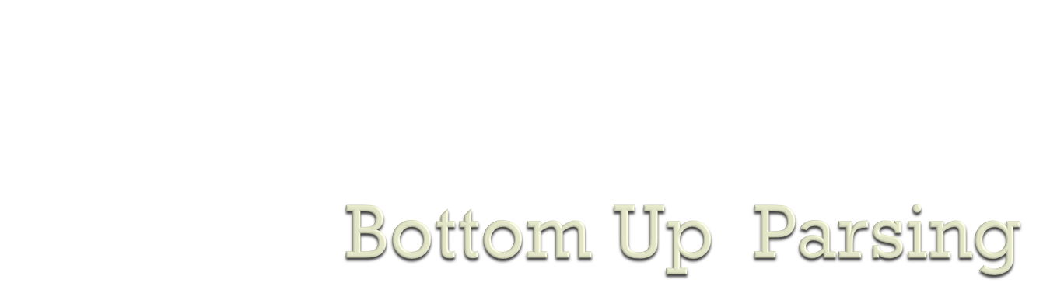

Slide 2


Top-down parsers (LL(1), recursive descent)
Start at the root of the parse tree and grow toward leaves
Pick a production & try to match the input
Bad “pick” ⇒ may need to backtrack
Some grammars are backtrack-free (predictive parsing)
Bottom-up parsers (LR(1), operator precedence)
Start at the leaves and grow toward root
As input is consumed, encode possibilities in an internal state
Start in a state valid for legal first tokens
Bottom-up parsers handle a large class of grammars

Slide 3

Top-down parsers build syntax tree from root to leaves
Left-recursion causes non-termination in top-down parsers
  Transformation to eliminate left recursion
  Transformation to eliminate common prefixes in right recursion
FIRST & FOLLOW sets + LL(1) condition
  LL(1) uses left-to-right scan of the input, leftmost derivation of the sentence, and 1 word lookahead
  LL(1) condition means grammar works for predictive parsing
Given an LL(1) grammar, we can
  Build a recursive descent parser
  Build a table-driven LL(1) parser
LL(1) parser doesn’t build the parse tree
  Keeps lower fringe of partially complete tree on the stack

Slide 4

There are two main categories of shift-reduce parsers
LR-Parsers
  covers wide range of grammars.
    SLR – simple LR parser
    Canonical LR – most general LR parser
    LALR – intermediate LR parser (lookhead LR parser)
  SLR, Canonical LR and LALR work same, only their parsing tables are different.
Operator-Precedence Parser
  simple, but only a small class of grammars.

Slide 5
Bottom-up parsing is more general than top-down parsing
Bottom-up parsers handle a large class of grammars.
Preferred method in practice
Also called LR parsing
  L means that tokens are read left to right
  R means that the parser constructs a rightmost derivation.
Notes:
compiler: Bottom-up Parsing
This is a note

Slide 6

Bottom-up parsing is more general than top-down parsing
Bottom-up parsers handle a large class of grammars.
Preferred method in practice
Also called LR parsing
    L means that tokens are read left to right
    R means that the parser constructs a rightmost derivation.
Notes:
compiler: Bottom-up Parsing
This is a note

Slide 7
Bottom-up parsing is more general than top-down parsing
Bottom-up parsers handle a large class of grammars.
Preferred method in practice
Also called LR parsing
  L means that tokens are read left to right
  R means that the parser constructs a rightmost derivation.
Notes:
compiler: Bottom-up Parsing
This is a note

Slide 8
Bottom-up parsing is more general than top-down parsing
Bottom-up parsers handle a large class of grammars.
Preferred method in practice
Also called LR parsing
  L means that tokens are read left to right
  R means that the parser constructs a rightmost derivation.
Notes:
compiler: Bottom-up Parsing
This is a note

Slide 9
Bottom-up parsing is more general than top-down parsing
Bottom-up parsers handle a large class of grammars.
Preferred method in practice
Also called LR parsing
  L means that tokens are read left to right
  R means that the parser constructs a rightmost derivation.
Notes:
compiler: Bottom-up Parsing
This is a note

Slide 10
Bottom-up parsing is more general than top-down parsing
Bottom-up parsers handle a large class of grammars.
Preferred method in practice
Also called LR parsing
  L means that tokens are read left to right
  R means that the parser constructs a rightmost derivation.
Notes:
compiler: Bottom-up Parsing
This is a note

Slide 11

LR parsers donot need left-factored grammars
LR parsers can handle left-recursive grammars
A derivation consists of a series of rewrite steps
S ⇒ g0 ⇒ g1 ⇒ ... ⇒ gn-1
⇒ gn ⇒ sentence

Slide 12
LR parsers donot need left-factored grammars
LR parsers can handle left-recursive grammars
A derivation consists of a series of rewrite steps
S ⇒ g0 ⇒ g1 ⇒ ... ⇒ gn-1
⇒ gn ⇒ sentence

Slide 13
LR parsers donot need left-factored grammars
LR parsers can handle left-recursive grammars
A derivation consists of a series of rewrite steps
S ⇒ g0 ⇒ g1 ⇒ ... ⇒ gn-1
⇒ gn ⇒ sentence

Slide 14
S ⇒ γ₀ ⇒ ... ⇒ γ_{n} ⇒ sentence
Each gi is a sentential form
if γ contains only terminals, γ is a sentence in L(G)
If γ contains ≥ 1 nonterminals, γ is a sentential form
A bottom-up parser builds a derivation by working from input sentence back towards the start symbol S
S ⇒ g0 ⇒ ... ⇒ gn ⇒ sentence

Slide 15
S ⇒ γ₀ ⇒ ... ⇒ γ_{n} ⇒ sentence
Each γ_{i} is a sentential form
if γ contains only terminals, γ is a sentence in L(G)
If γ contains ≥ 1 nonterminals, γ is a sentential form
A bottom-up parser builds a derivation by working from input sentence back towards the start symbol S
S ⇒ g0 ⇒ ... ⇒ gn ⇒ sentence

Slide 16
S ⇒ γ₀ ⇒ ... ⇒ γ_{n} ⇒ sentence
Each γ_{i} is a sentential form
if γ contains only terminals, γ is a sentence in L(G)
If γ contains ≥ 1 nonterminals, γ is a sentential form
A bottom-up parser builds a derivation by working from input sentence back towards the start symbol S
S ⇒ g0 ⇒ ... ⇒ gn ⇒ sentence

Slide 17
S ⇒ γ₀ ⇒ ... ⇒ γ_{n} ⇒ sentence
Each γ_{i} is a sentential form
if γ contains only terminals, γ is a sentence in L(G)
If γ contains ≥ 1 nonterminals, γ is a sentential form
A bottom-up parser builds a derivation by working from input sentence back towards the start symbol S
S ⇒ g0 ⇒ ... ⇒ gn ⇒ sentence

Slide 18
The sentence abbcde can be reduced to S:
abbcde
aAbcde
aAde
aABe
S
S → aABe
A → Abc | b
B → d

Slide 19
The sentence abbcde can be reduced to S:
abbcde
aAbcde
aAde
aABe
S
S → aABe
A → Abc | b
B → d

Slide 20
The sentence abbcde can be reduced to S:
abbcde
aAbcde
aAde
aABe
S
S → aABe
A → Abc | b
B → d

Slide 21
The sentence abbcde can be reduced to S:
abbcde
aAbcde
aAde
aABe
S
S → aABe
A → Abc | b
B → d

Slide 22
The sentence abbcde can be reduced to S:
abbcde
aAbcde
aAde
aABe
S
S → aABe
A → Abc | b
B → d

Slide 23
These reductions, in fact, trace out the following right-most derivation in reverse:
S ⇒ aABe
⇒ aAde
⇒ aAbcde
⇒ abbcde
Abbcde
aAbcde
aAde
aABe
S

Slide 24

1. E → E + (E)
2. | int
Consider bottom-up parse of the string
int + (int) + (int)
int + (int) + (int)
E + (int) + (int)
E
int
+
(
int
)
+
(
int
)

Slide 25
1. E → E + (E)
2. | int
Consider bottom-up parse of the string
int + (int) + (int)
int + (int) + (int)
E + (int) + (int)
E + (E) + (int)
E
E
int
+
(
int
)
+
(
int
)

Slide 26
1. E → E + (E)
2. | int
Consider bottom-up parse of the string
int + (int) + (int)
int + (int) + (int)
E + (int) + (int)
E + (E) + (int)
E + (int)
E
E
E
int
+
(
int
)
+
(
int
)

Slide 27
1. E → E + (E)
2. | int
Consider bottom-up parse of the string
int + (int) + (int)
int + (int) + (int)
E + (int) + (int)
E + (E) + (int)
E + (E)
E +(int)
E
E
E
E
int
+
(
int
)
+
(
int
)

Slide 28

1. E → E + (E)
2. | int
E
A rightmost derivation in reverse
int + (int) + (int)
E + (int) + (int)
E + (E) + (int)
E + (int)
E + (E)
E
E
E
E
E
int
+
(
int
)
+
(
int
)

Slide 29
S ⇒× αBy ⇒ αγy ⇒× xy
rm
rm
rm
S
rule: B → γ
B
α
γ
x
y
x
Terminals only

Slide 30

Let a β γ be a step of a bottom-up parse
Assume that next reduction is A → β
Then γ is a string of terminals!
Why?
Because aA γ → a β γ is a step in a rightmost derivation
Idea:
Split the string into two substrings
Right substring (a string of terminals) is as yet unexamined by parser
Left substring has terminals and non-terminals

Slide 31

The dividing point is marked by a ►
  The ► is not part of the string
Initially, all input is unexamined:
►x₁ . . . x_{n}

Slide 32

Bottom-up parsing uses only two kinds of actions:
1. Shift
2. Reduce
1. SHIFT
Move ► one place to the right
shifts a terminal to the left string
E + (► int) ⇒ E + (int ►)
2. REDUCE
Apply an inverse production at the right end of the left string. If E → E + (E) is a production, then
E + ( E+(E)►) ⇒ E + ( E ►)

Slide 33
►int + (int) + (int) $ | shift
int ► + (int) + (int) $ | reduce E → int
E ► + (int) + (int) $ | shift 3 times
E + (int ►) + (int) $ | reduce E → int
E + (E ►) + (int) $ | shift
E + (E) ► + (int) $ | reduce E → E+(E)

Slide 34
►int + (int) + (int) $ | shift
int ► + (int) + (int) $ | reduce E → int
E ► + (int) + (int) $ | shift 3 times
E + (int ►) + (int) $ | reduce E → int
E + (E ►) + (int) $ | shift
E + (E) ► + (int) $ | reduce E → E+(E)

Slide 35
►int + (int) + (int) $ | shift
int ► + (int) + (int) $ | reduce E → int
E ► + (int) + (int) $ | shift 3 times
E + (int ►) + (int) $ | reduce E → int
E + (E ►) + (int) $ | shift
E + (E) ► + (int) $ | reduce E → E+(E)

Slide 36
►int + (int) + (int) $ | shift
int ► + (int) + (int) $ | reduce E → int
E ► + (int) + (int) $ | shift 3 times
E + (int ►) + (int) $ | reduce E → int
E + (E ►) + (int) $ | shift
E + (E) ► + (int) $ | reduce E → E+(E)

Slide 37
►int + (int) + (int) $ | shift
int ► + (int) + (int) $ | reduce E → int
E ► + (int) + (int) $ | shift 3 times
E + (int ►) + (int) $ | reduce E → int
E + (E ►) + (int) $ | shift
E + (E) ► + (int) $ | reduce E → E+(E)

Slide 38
►int + (int) + (int) $ | shift
int ► + (int) + (int) $ | reduce E → int
E ► + (int) + (int) $ | shift 3 times
E + (int ►) + (int) $ | reduce E → int
E + (E ►) + (int) $ | shift
E + (E) ► + (int) $ | reduce E → E+(E)

Slide 39
►int + (int) + (int) $ | shift
int ► + (int) + (int) $ | reduce E → int
E ► + (int) + (int) $ | shift 3 times
E + (int ►) + (int) $ | reduce E → int
E + (E ►) + (int) $ | shift
E + (E) ► + (int) $ | reduce E → E+(E)

Slide 40
►int + (int) + (int) $ | shift
int ► + (int) + (int) $ | reduce E → int
E ► + (int) + (int) $ | shift 3 times
E + (int ►) + (int) $ | reduce E → int
E + (E ►) + (int) $ | shift
E + (E) ► + (int) $ | reduce E → E+(E)

Slide 41
►int + (int) + (int) $ | shift
int ► + (int) + (int) $ | reduce E → int
E ► + (int) + (int) $ | shift 3 times
E + (int ►) + (int) $ | reduce E → int
E + (E ►) + (int) $ | shift
E + (E) ► + (int) $ | reduce E → E+(E)

Slide 42
►int + (int) + (int) $ | shift
int ► + (int) + (int) $ | reduce E → int
E ► + (int) + (int) $ | shift 3 times
E + (int ►) + (int) $ | reduce E → int
E + (E ►) + (int) $ | shift
E + (E) ► + (int) $ | reduce E → E+(E)

Slide 43
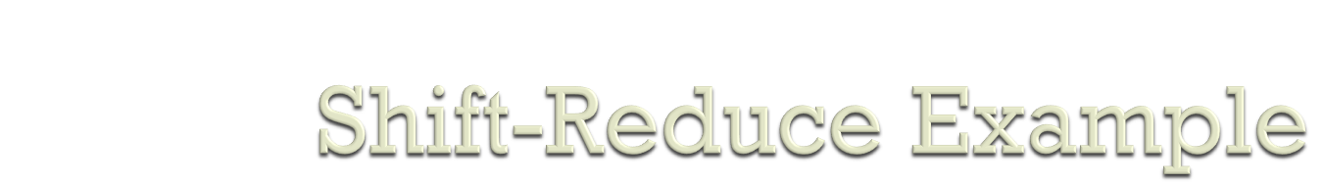
E ► + (int) $ | shift 3 times
E + (int ►) $ | reduce E → int
E + (E ►) $ | shift
E + (E) ► $ | red E → E+(E)
E ► $ | accept

Slide 44
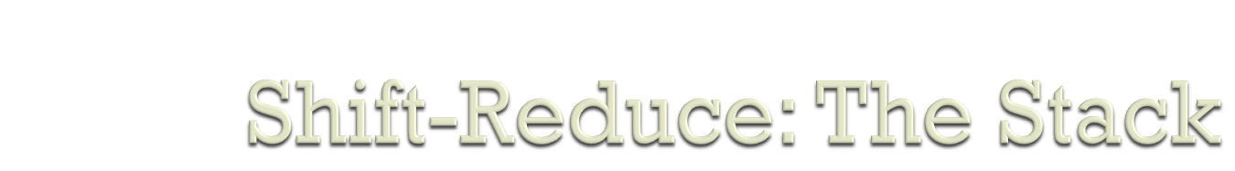
Left string can be implemented as a stack
Top of the stack is the ►
Shift pushes a terminal on the stack
Notes:
compiler: Bottom-up Parsing
end of lec 20

Slide 45
►int + (int) + (int) $ | shift
int ► + (int) + (int) $ | reduce E → int
E ► + (int) + (int) $ | shift 3 times
E + (int ►) + (int) $ | reduce E → int
int
(
+
►
E
stack

Slide 46
Reduce pops zero or more symbols from the stack (production rhs) and pushes a non-terminal on the stack (production lhs)

Slide 47
►int + (int) + (int) $ | shift
int ► + (int) + (int) $ | reduce E → int
E ► + (int) + (int) $ | shift 3 times
E + (int ►) + (int) $ | reduce E → int
E
►
int
(
+
E
stack

Slide 48

A bottom-up parser builds the parse tree starting with its leaves and working toward its root
The upper edge of this partially contructed parse tree is called its upper frontier.

Slide 49
int + (int) + (int)
E + (int) + (int)
E + (E) + (int)
E + (int)
E + (E)
E
E
E
E
int
+
(
int
)
+
(
int
)

Slide 50
At each step, the parser looks for a section of the upper frontier that matches right-hand side of some production.
When it finds a match, the parser builds a new tree node with the production’s left-hand non-terminal thus extending the frontier upwards towards the root.
The critical step is developing an efficient mechanism that finds matches along the tree’s current frontier.

Slide 51
Formally, the parser must find some substring β, of the upper frontier where
1. β is the right-hand side of some production A → β, and
2. A → β is one step in right-most derivation of input stream

Slide 52
We can represent each potential match as a pair ⟨A→β,k⟩, where k is the position on the tree’s current frontier of the right-end of β.
The pair ⟨A→β,k⟩, is called the handle of the bottom-up parse.
A bottom-up parser operates by repeatedly locating handles on the frontier of the partial parse tree and performing reductions that they specify.

Slide 53

The bottom-up parser uses a stack to hold the frontier.
The stack simplifies the parsing algorithm in two ways.

Slide 54
First, the stack trivializes the problem of managing space for the frontier
  To extend the frontier, the parser simply pushes the current input token onto the top of the stack
Second, the stack ensures that all handles occur with their right end at the top of the stack
  eliminates the need to represent handle’s position

Slide 55
E ► + (int) $ | shift 3 times
E + (int ►) $ | reduce E → int
E + (E ►) $ | shift
E + (E) ► $ | red E → E+(E)
E ► $ | accept
1
2
3
4
handle: ⟨E→int,4⟩
handle: ⟨E→E+(E),5⟩

